Slide 1


EASWARI ENGINEERING COLLEGE
(An Autonomous Institution)
Bharathi Salai, Chennai Ramapuram, – 6000 89
DEPARTMENT OF COMPUTER SCIENCE & ENGINEERING
191CSP811J - PROJECT WORK / STARTUP – PHASE - II
FINAL PROJECT REVIEW
SENSOR BASED CHEMICAL ADULTERATION DETECTION IN FRUITS USING MACHINE LEARNING
Student Members:
Lijesh S(310621104084)
Nagavelan G(310621104101)
Pichu Snegan I(310621104115)
Supervisor:
Dr.Padmavati B
Assistant Professor/CSE
1

Slide 2
Introduction
Chemical adulteration in fruits poses serious health risks, requiring effective detection methods.
Traditional detection techniques are slow and depend on laboratory facilities.
Sensor-based systems combined with machine learning enable real-time adulteration detection.
Machine learning models analyze sensor data to identify contaminants in fruits.
This approach enhances food safety, reduces human effort, and provides a cost-effective solution.

Slide 3
Objective(s)
Develop a sensor-based system for detecting chemical adulteration in fruits.
Utilize machine learning algorithms to analyze sensor data for accurate identification.
Provide a real-time, non-destructive, and efficient adulteration detection method.
Enhance food safety by minimizing human intervention and laboratory dependency.
Offer a cost-effective and scalable solution for widespread use.

Slide 4
Motivation
Increasing health risks due to chemical adulteration in fruits.
Limitations of traditional laboratory-based detection methods.
Need for a real-time, non-destructive, and efficient detection system.
Advancements in sensor technology and machine learning for improved accuracy.
Demand for a cost-effective and scalable solution to ensure food safety.

Slide 5
Literature Survey
Author name | Title of the paper | Journal name//Year | Concept
José Luis P. Calle, Marta Barea-Sepúlveda, Ana Ruiz-Rodríguez, José Ángel Álvarez, Marta Ferreiro-González, Miguel Palma | "Rapid Detection and Quantification of Adulterants in Fruit Juices Using Machine Learning Tools and Spectroscopy Data" | Sensors ,2022 | This study combines machine learning models with near-infrared spectroscopy to detect and quantify adulteration in fruit juices. The methodology achieved high accuracy in identifying adulterated samples and quantifying adulterant levels.
Abdus Sattar, Md Asif Mahmud Ridoy, et al. | A Comprehensive Approach to Detecting Chemical Adulteration in Fruits Using Computer Vision, Deep Learning, and Chemical Sensors | Intelligent Systems with Applications ,2024 | This research integrates computer vision, deep learning, and chemical sensors to detect harmful additives in fruits. The proposed hybrid model utilizes formaldehyde detection sensors and image data to identify adulteration with high accuracy.

Slide 6
Literature Survey
Author name | Title of the paper | Journal name//Year | Concept
Pasha, Sneha, et al. | Detection of Adulteration in Fruits Using Machine Learning | International Journal of Creative Research Thoughts (IJCRT) ,2023 | This paper presents a machine learning-based technique to detect formalin adulteration in fruits. The system employs supervised learning algorithms to predict formalin concentration and distinguish between artificially added and naturally occurring formalin.
Kashish Goyal, Parteek Kumar, Karun Verma | Food Adulteration Detection Using Artificial Intelligence: A Systematic Review | Archives of Computational Methods in Engineering, 2021 | This systematic review explores the role of artificial intelligence in detecting food adulteration, highlighting various machine learning and deep learning applications in ensuring food quality and safety.

Slide 7
Literature Survey
Author name | Title of the paper | Journal name//Year | Concept
Siyu Liu, Shiming Li, Chitang Ho | Detection of Adulteration in Fruits Using Machine Learning | ResearchGate ,2021 | This research develops a machine-learning-based food and formalin detection technique utilizing the Internet of Things. By applying algorithms such as logistic regression, support vector machines, and K-NN classifiers to the experimental dataset, the system tracks artificially added formalin used as a preservative.
Pasha, Sneha, et al. | Detection of Adulteration in Fruits Using Machine Learning | International Journal of Creative Research Thoughts (IJCRT) Year: 2023 | This paper presents a machine learning-based technique to detect formalin adulteration in fruits. The system employs supervised learning algorithms to predict formalin concentration and distinguish between artificially added and naturally occurring formalin.

Slide 8
Issues in Existing system
Traditional laboratory-based detection methods require significant time for sample collection, testing, and analysis.
Chemical analysis and lab equipment are expensive, making large-scale testing impractical.
Most existing methods require specialized laboratory settings, limiting real-time detection capabilities.
Farmers and consumers lack easy access to adulteration detection tools.
Manual and chemical-based tests may have inconsistencies and errors in detecting low levels of adulteration.

Slide 9
Proposed System
Utilizes sensor technology to detect chemical adulteration in fruits in real time.
Integrates machine learning algorithms for accurate and automated adulteration identification.
Provides a portable, cost-effective, and user-friendly solution for farmers and consumers.
Enables rapid and non-destructive testing without the need for laboratory facilities.
Enhances food safety by offering a scalable and efficient detection system.

Slide 10
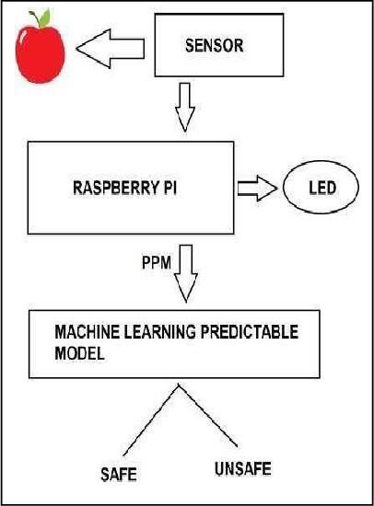
Architecture Diagram
10

Slide 11
List of modules
Data collection module – Gathers sensor data from fruit samples, including chemical composition and physical properties.
Preprocessing module – Cleans, normalizes, and prepares sensor data for analysis.
Feature extraction module – Identifies relevant attributes for machine learning classification.

Slide 12
Module 1- Data collection module
Sensor integration – Connects chemical and physical sensors to capture data from fruit samples.
Real-time data acquisition – Continuously collects data on chemical properties, including pH, formalin levels, and pesticide residues.
Multi-sensor fusion – Combines readings from multiple sensors for improved accuracy.
Data logging – Stores raw sensor data for further processing and machine learning analysis.
Wireless communication – Transfers collected data to a central processing system for real-time detection.

Slide 13
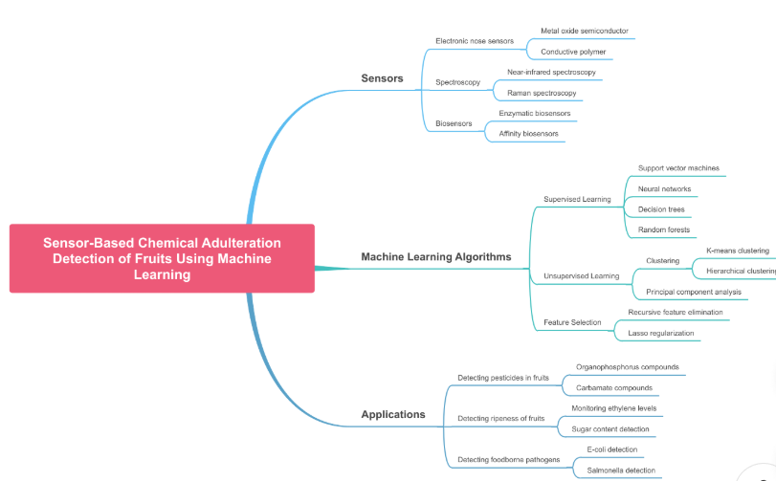
Functional Architecture of Module 1

Slide 14
Algorithm Used
Support Vector Machine (SVM) – Classifies adulterated and non-adulterated samples based on sensor data patterns.
Random Forest – Uses multiple decision trees to improve accuracy in detecting adulteration.
K-Nearest Neighbors (KNN) – Compares new samples with stored data to identify adulterants.
Artificial Neural Networks (ANN) – Learns complex patterns in sensor data for precise classification.
Principal Component Analysis (PCA) – Reduces dimensionality and selects important features for better model performance.

Slide 15
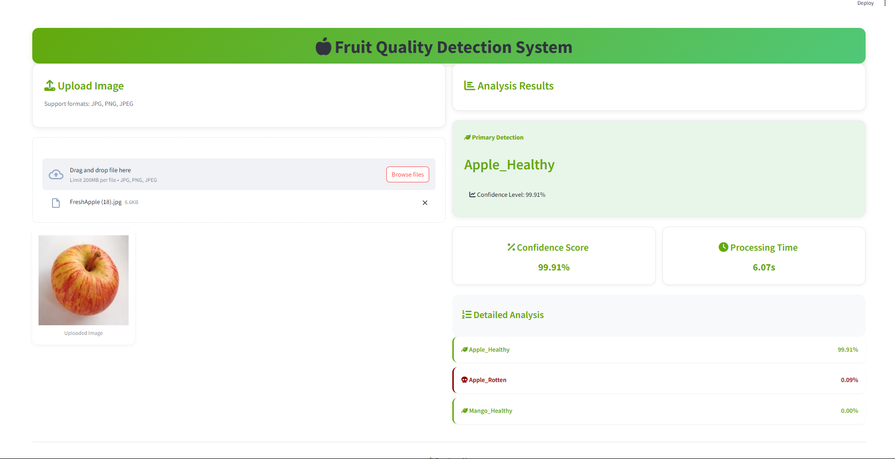
Implementation

Slide 16
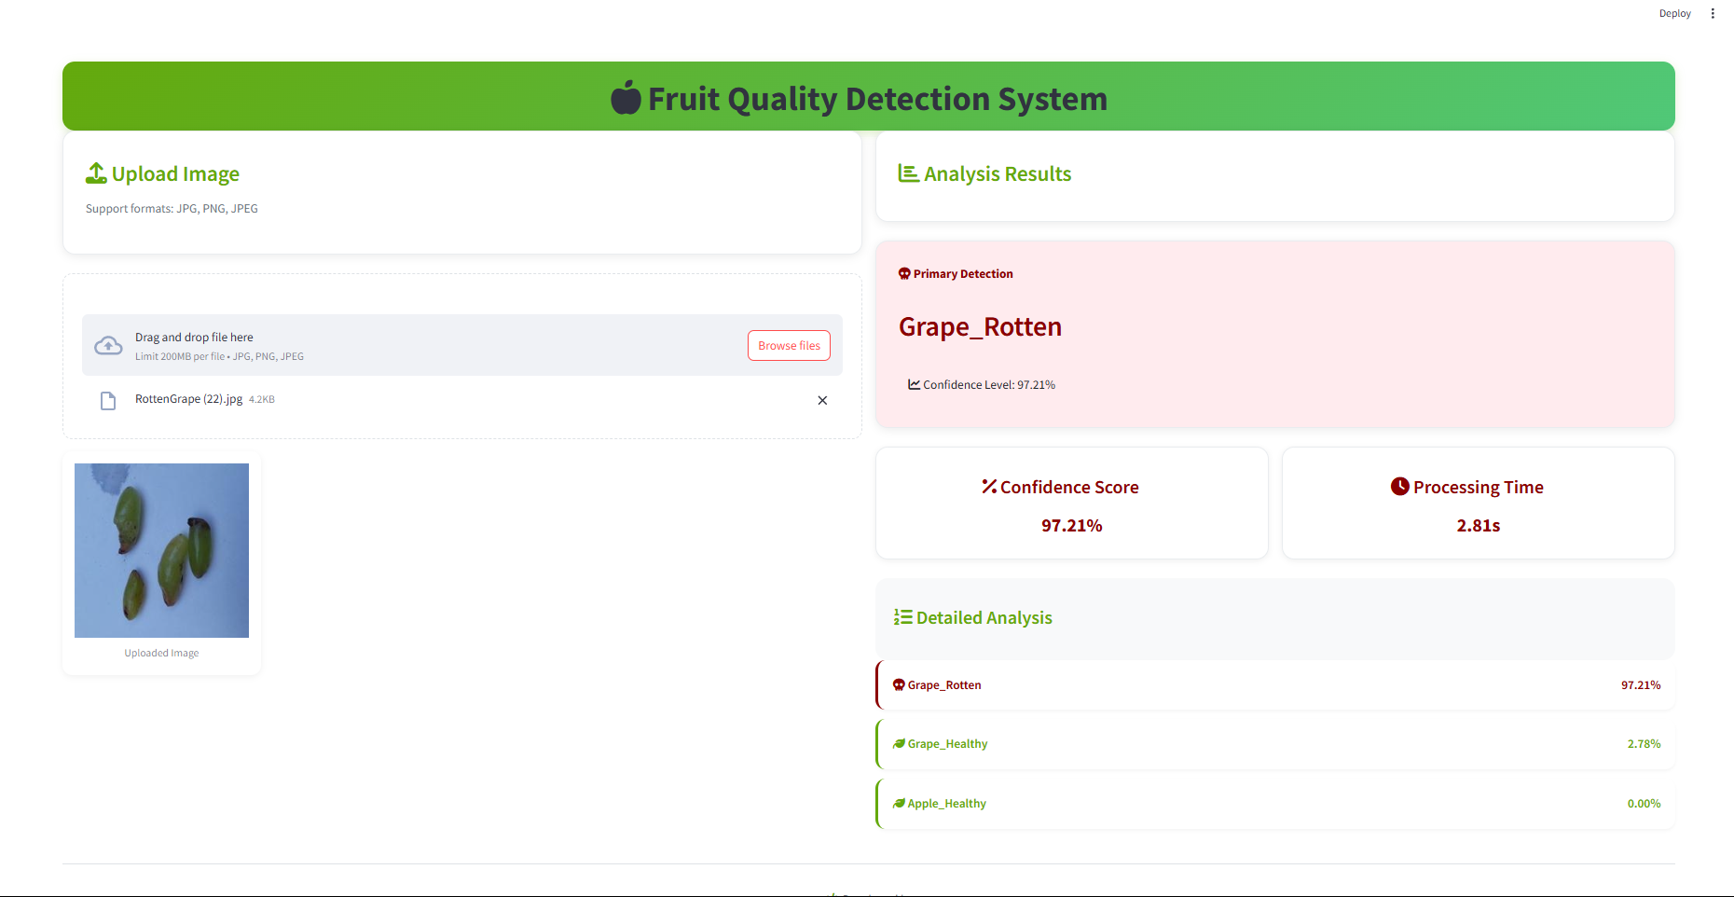
Implementation

Slide 17
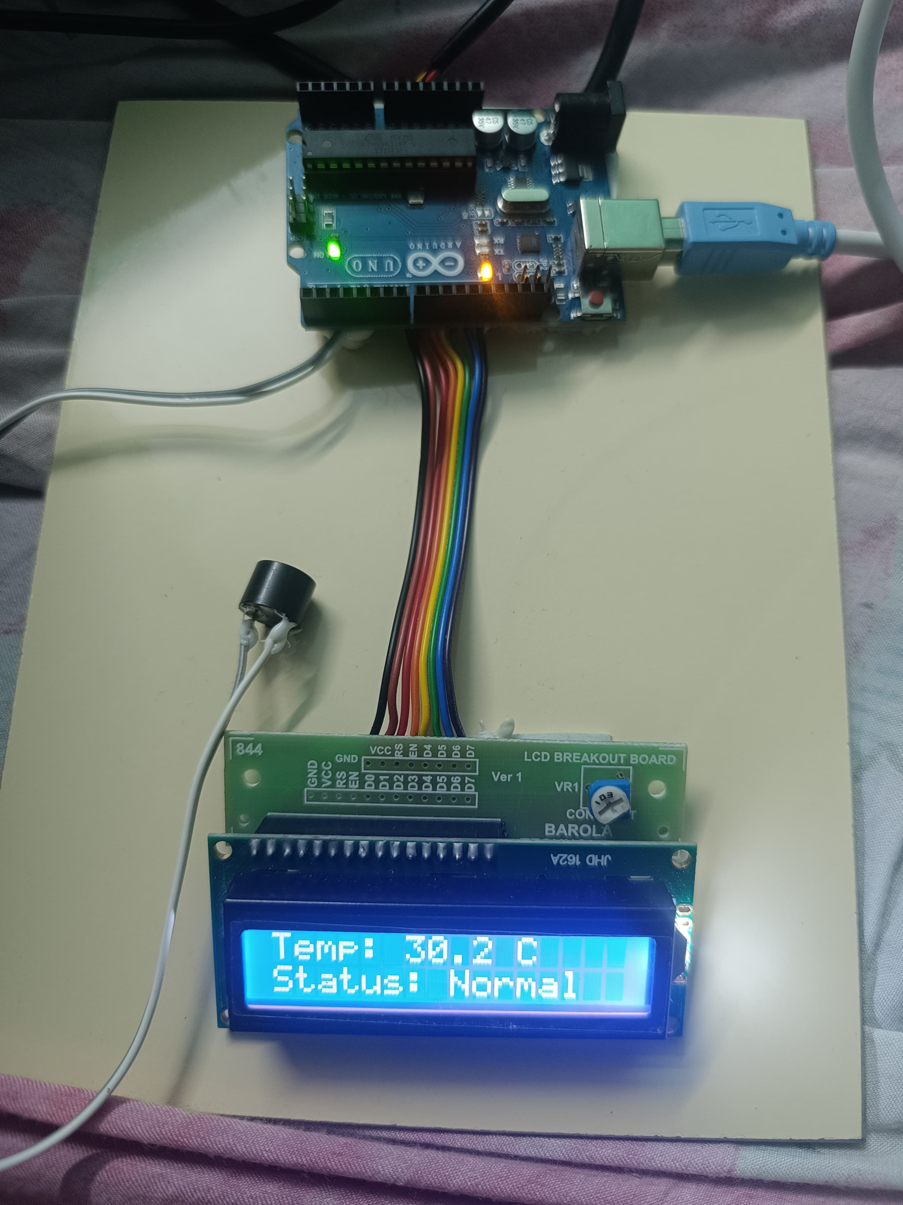
Implementation

Slide 18
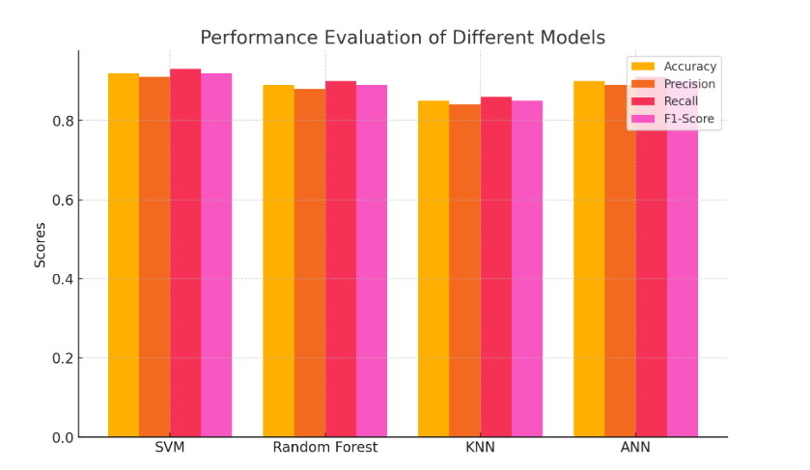
Performance Evaluation

Slide 19
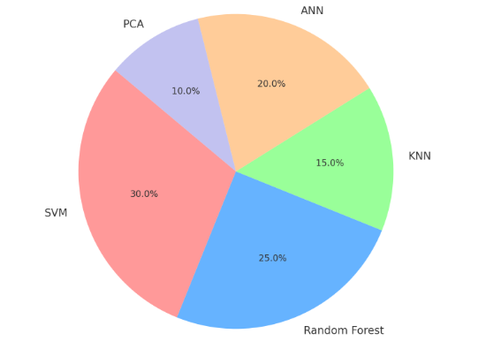
Performance Evaluation

Slide 20
System Requirements
SOFTWARE:
Python, TensorFlow, scikit-learn
Pandas, NumPy, Matplotlib,Streamlit
HARDWARE:
Temperature Sensor,Aurdino UNO,Buzzer,LED Display
TECHNOLOGY USED:
Machine learning (SVM, Random Forest, ANN)
IoT for real-time detection
Data analytics and visualization

Slide 21
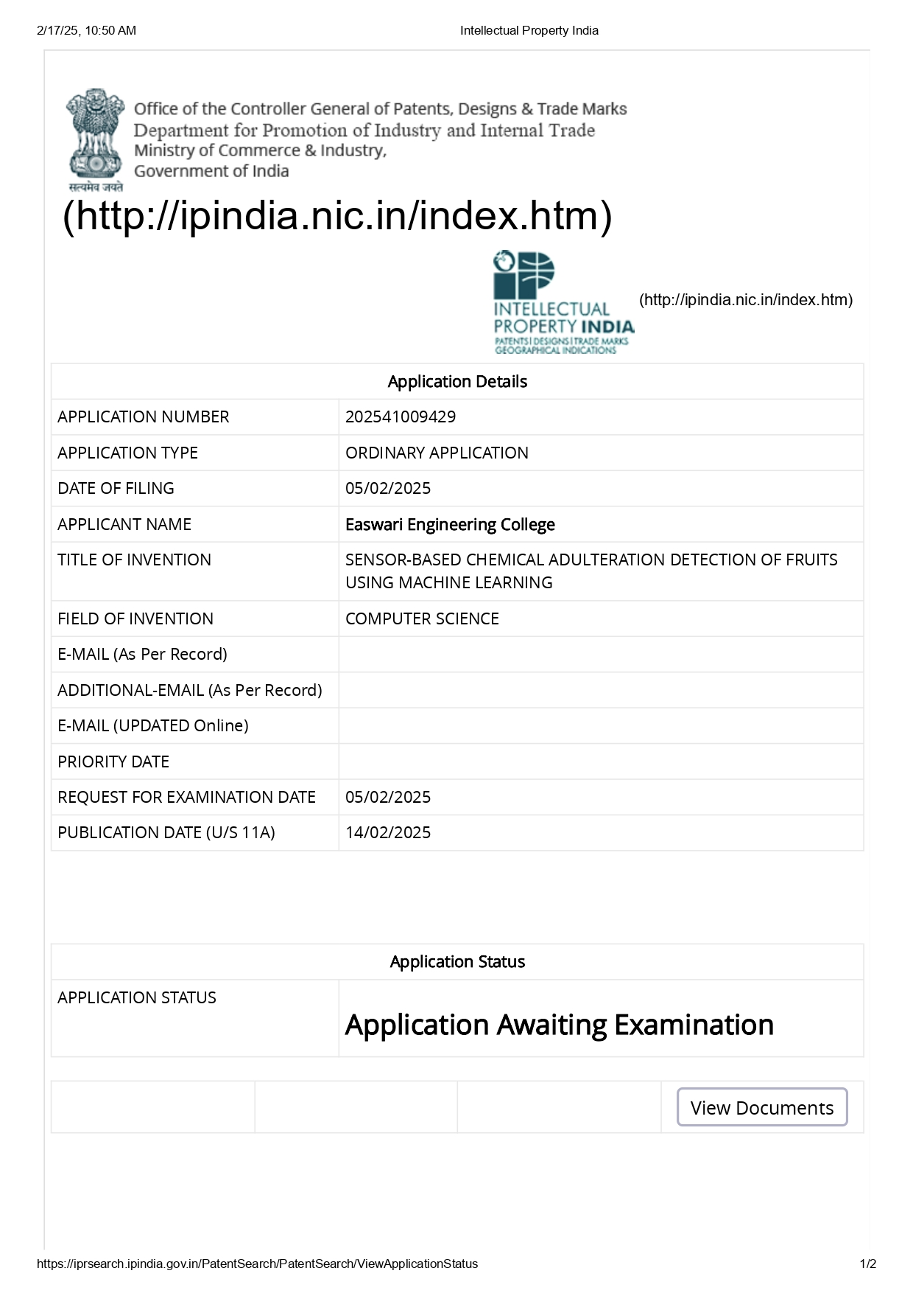
List of Publications

Slide 22
References
M. Samad Khan, F. Nowshad, and M. d. N. Islam, "Concentration and formation behavior of naturally occurring formaldehyde in foods," Nowshad et al. Agric & Food Secur, 2018.
K. Everstine, J. Spink, S. Kennedy, Economically motivated adulteration (EMA) of food: common characteristics of EMA incidents, J. Food Protect. 76 (4) (2013) 723–735
P.J. Ramos, F.A. Prieto, E.C. Montoya, C.E. Oliveros, Automatic fruit count on coffee branches using computer vision, Comput. Electron. Agric. 137 (2017) 9–22
22

Slide 23
References
S. Dea, E. A. Baldwin, J. Bai, and A. Plotto, "Electronic noses and tongues: Applications for the food and pharmaceutical industries." Sensors, 2011
A. W. Reza, S. D. Barman, K. Tabassum, A. A. Memi, and N. Sultana, "Food and formalin detector using machine learning." International Journal of Machine Learning and Computing, 2019.
C.C. Wee, V.K. Subbiah, M. Arita, H.H. Goh, The applications of network analysis in fruit ripening, Sci. Hortic. 311 (Mar. 2023), 111785
23

Slide 24
Thank You
24

